Slide 1
A Shallow Introduction To Deep Learning
Dr. Victoria Passov-Mazo
June 15, 2016
Notes:
1

Slide 2
Outline
Background on Artificial Intelligence
Deep learning overview
State-of-the-art examples

Slide 3
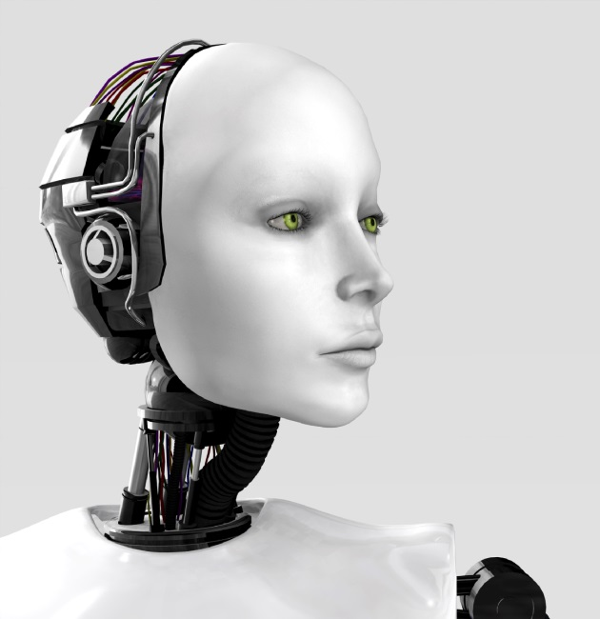
Artificial Intelligence
Algorithms which learn from examples (instead of rules) in a supervised/unsupervised manner
Today’s Neural Networks are an example of Weak Artificial Intelligence
Other examples of Weak Artificial Intelligence: Linear/logistic regression, SVM, Decision Trees, Clustering, Bayesian Graphical Models, etc.
Hopefully Strong Artificial Intelligence in the future (2040 - ?)
Notes:
3

Slide 4
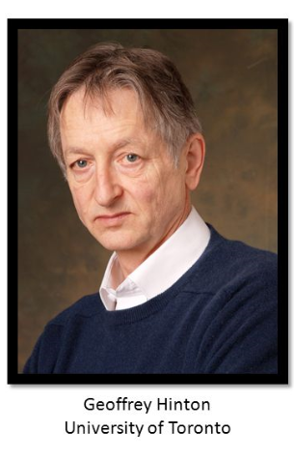
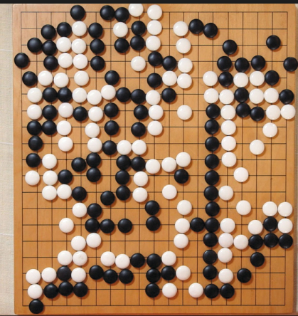
Historical Perspective of Neural Networks
1965 – First known deep network (by Ivakhnenko and Lapa)
1980-1990s – Shallow neural networks, working examples
Autonomous driving (Navlab, 1990)
Handwriting recognition (LeCun, 1993)
1990s – Decline (costly and hard to train)
2006 – Revival, deep neural networks
2016 – Human-level performance demos for
Image recognition: Google’s Inception v4
Face recognition: DeepFace, FaceNet
Speech recognition: Baidu's Deep Speech 2
Game playing: Google’s AlphaGo

Slide 5
Applications of Neural Networks
Computer vision
Image classification (Google Photos)
Face recognition (Facebook’s face tagging)
Object detection and tracking
OCR
Video (MSQRD, surveillance, autonomous cars)
Speech recognition (Siri, Google Ok, Baidu’s Deep Speech)
Natural language processing (Google’s Machine Translation, Sentiment Analysis, online advertisement)
Information retrieval (Google search engine, IBM’s Watson Question answering)
Medical
Diagnosis suggestion
Monitoring
Brain–computer interface
Spam/Fraud/Cyber attack detection
Financial engineering (algotrading)
Game playing (DeepMind’s Atari, Google’s AlphaGo)
Recommendation systems (Netflix)
Robotics

Slide 6
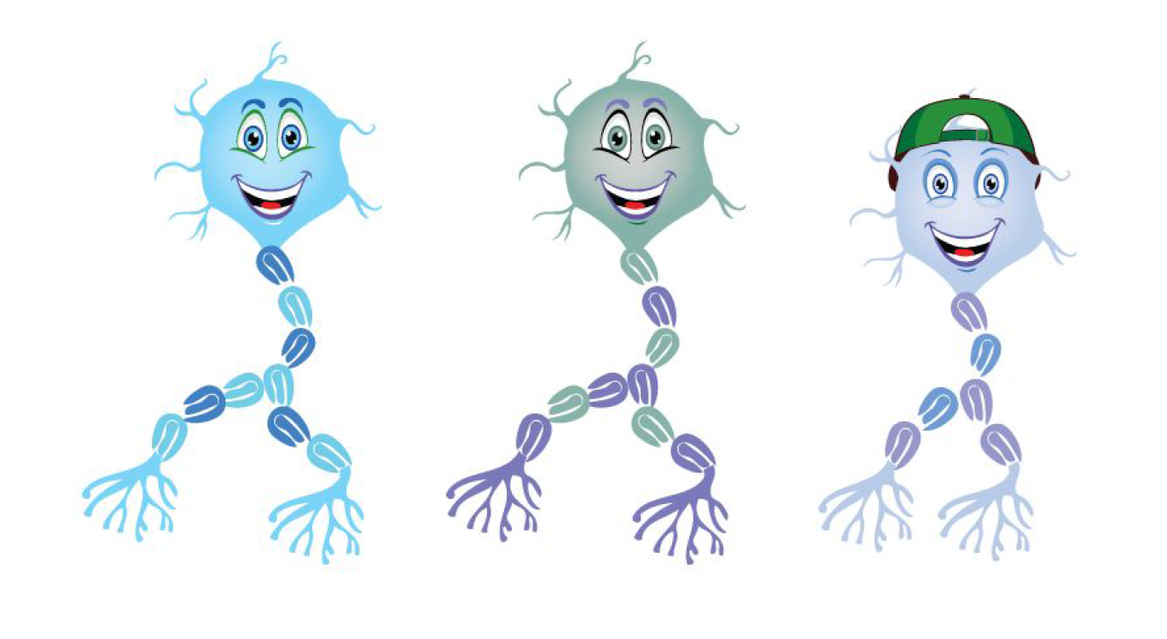
Biological Neural Networks

Slide 7
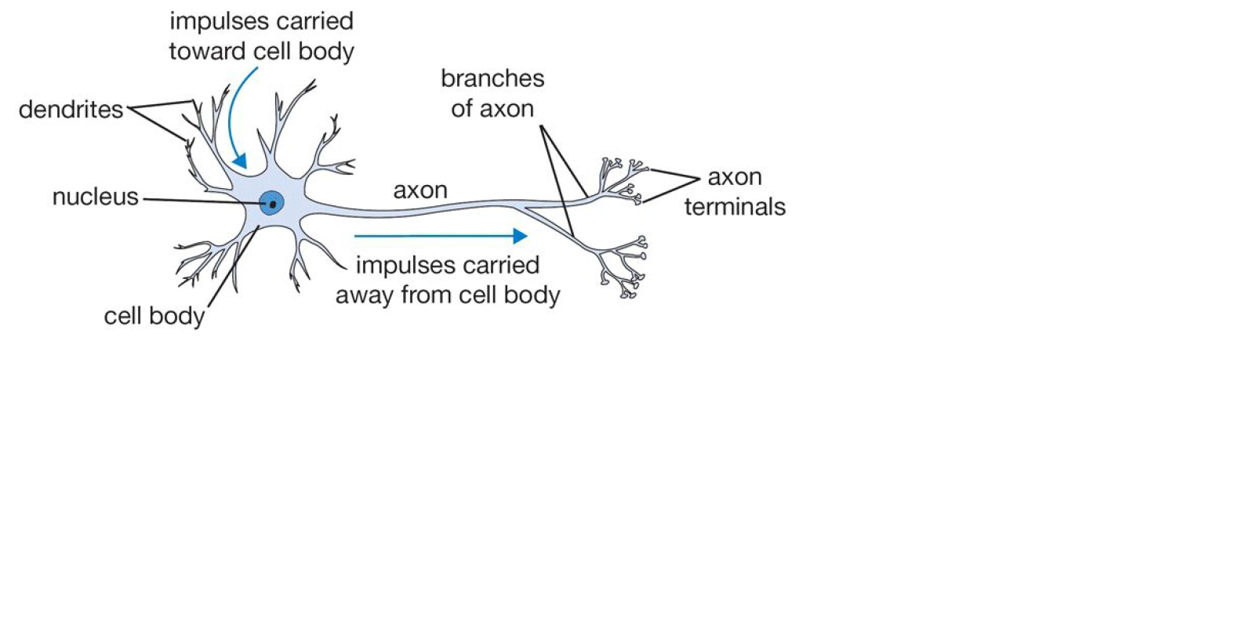
Biological Neural Networks

Slide 8
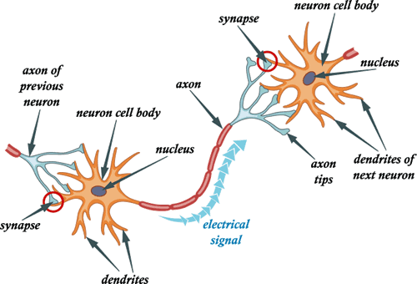
Biological Neural Networks

Slide 9
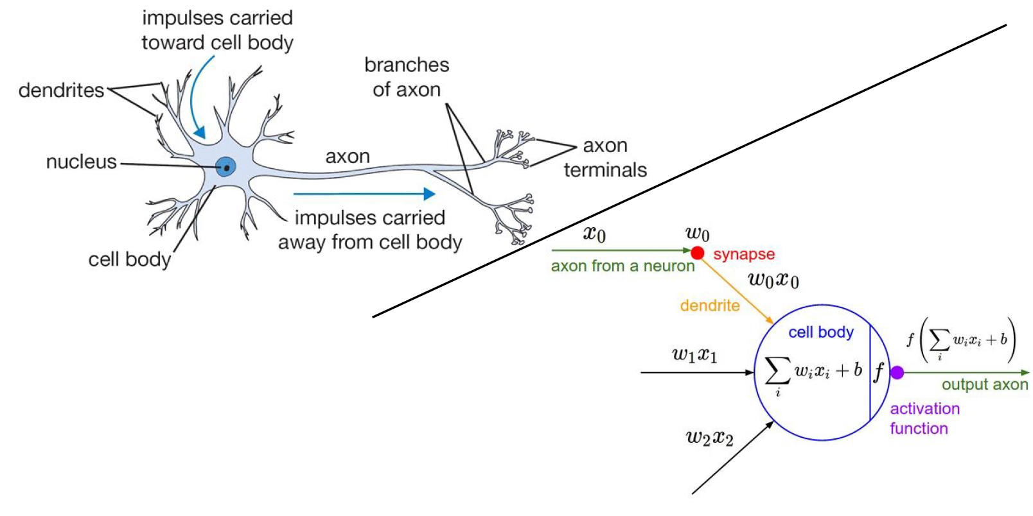
Biological Neural Networks

Slide 10
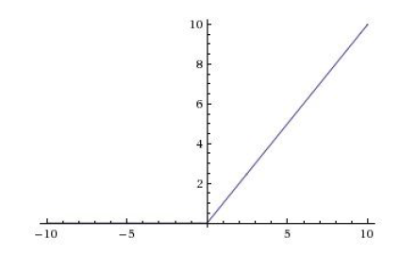
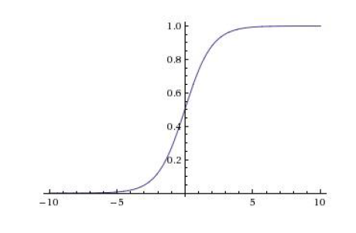
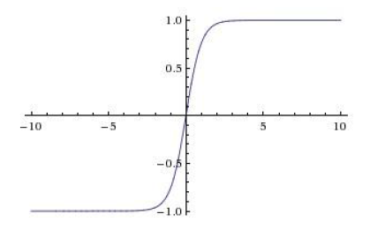
Biological Neural Networks
ReLU
Sigmoid
tanh
f
f
f

Slide 11
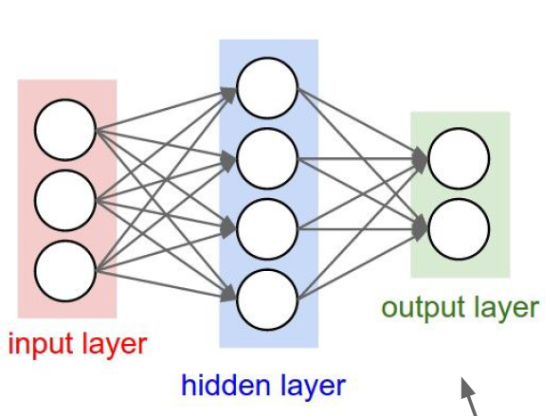
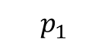
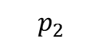
Neural Network with One Hidden Layer
Perceptron’s output are probabilities for each category
Weights
Weights
f
f
f
f

Slide 12
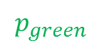

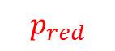

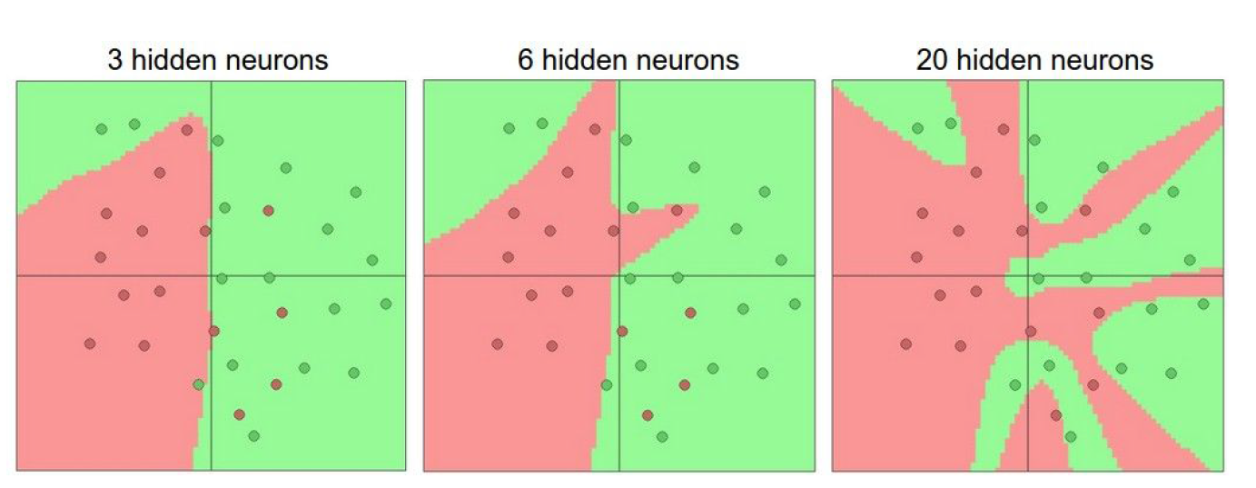
Neural Network with One Hidden Layer
x
➔ green
y
➔ red
y
x

Slide 14
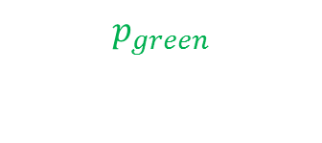
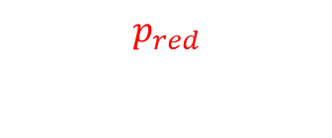
Learning
Weights
Weights
x
Loss
for point (x,y)
y
Forward propagation

Slide 15
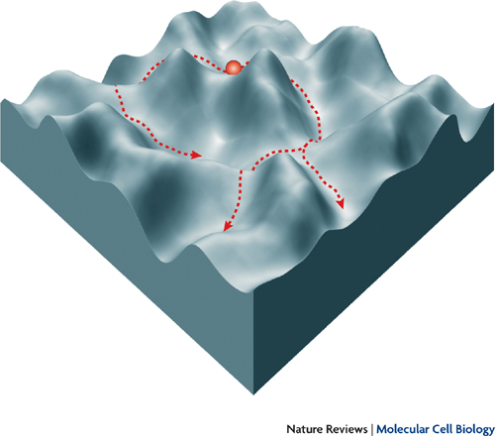
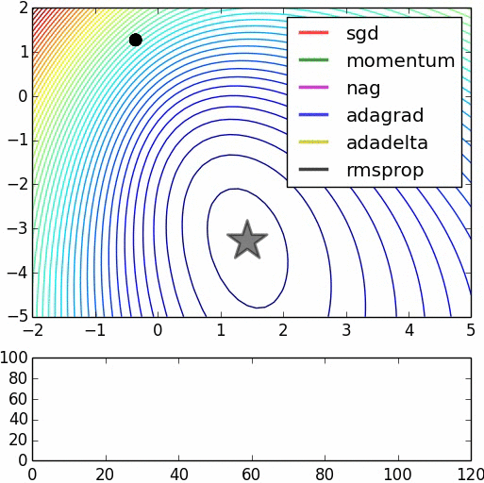
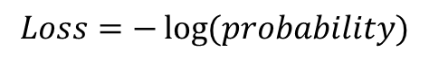
Learning
Loss landscape
Gradient decent

Slide 16
Learning
Update of weights with error (gradients)
Weights
Weights
x
error
y
Backward propagation

Slide 17
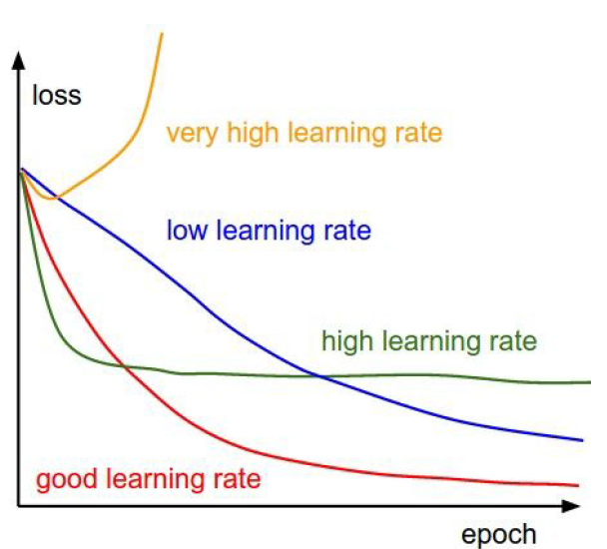
Loss

Slide 18
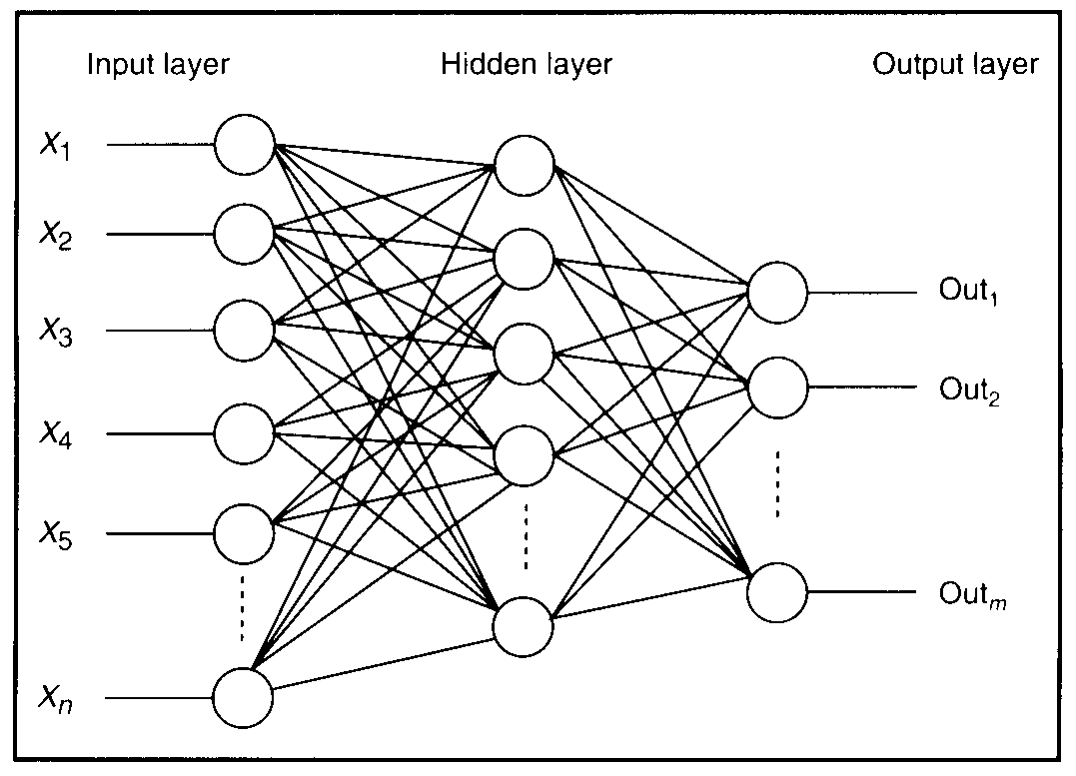
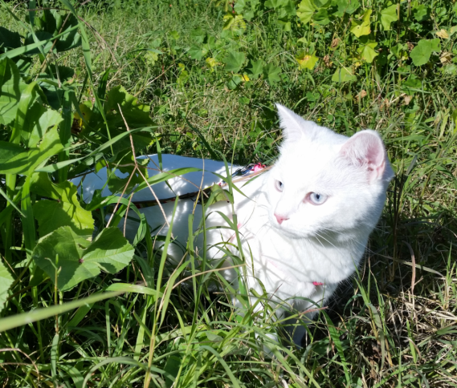


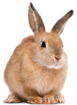
Neural Network with One Hidden Layer
Weights
Pixels of an image
f
Weights
f
0.7
f
0.1
f
0.05
f
Notes:
18

Slide 19
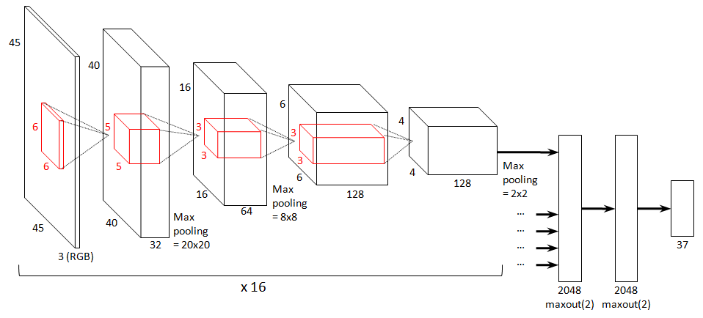
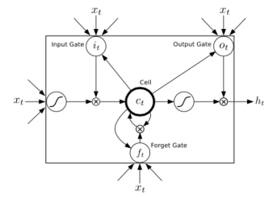
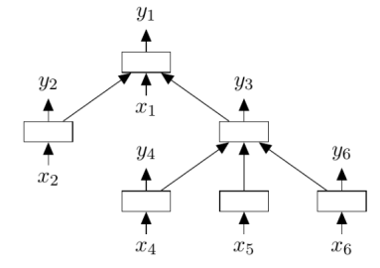
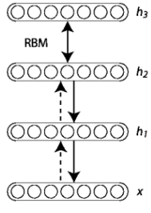
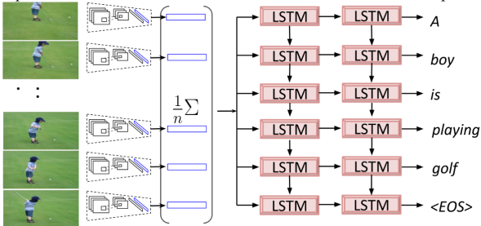
Types of NN Architectures
Convolutional
Recurrent (RNN, LSTM)
Autoencoder
Reinforcement Learning
Various combinations

Slide 20

Convolutional Network
Best for images and video

Slide 21
Convolutional Network
visualization

Slide 22
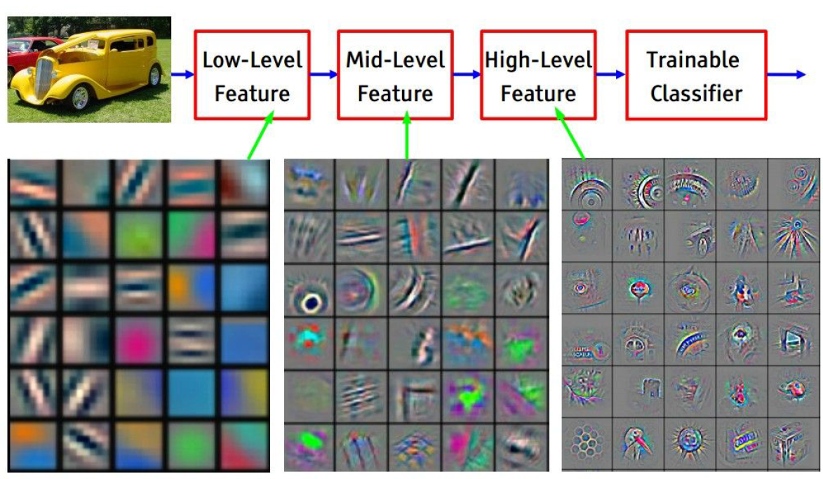
Convolutional Network
Automatic feature learning, instead of manual feature engineering
Hierarchical features: from simple patterns to high-level concepts
End-to-end solutions
video

Slide 23
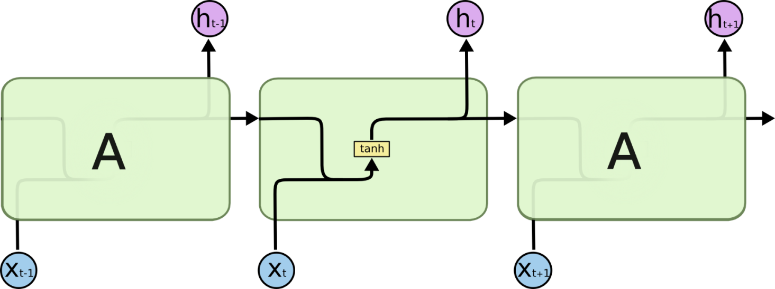
Recurrent Neural Network
RNN = Recurrent Neural Network
Time

Slide 24

Recurrent Neural Network
RNN = Recurrent Neural Network
LSTM = Long Short-Term Memory
Time

Slide 25
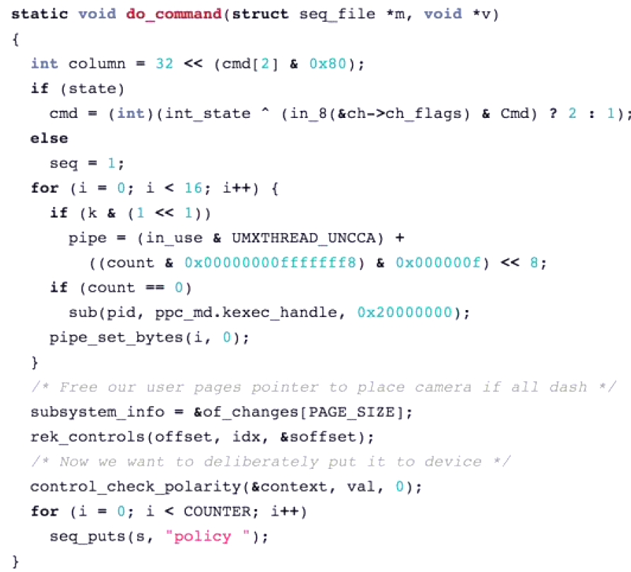
Generated C code by RNN

Slide 26
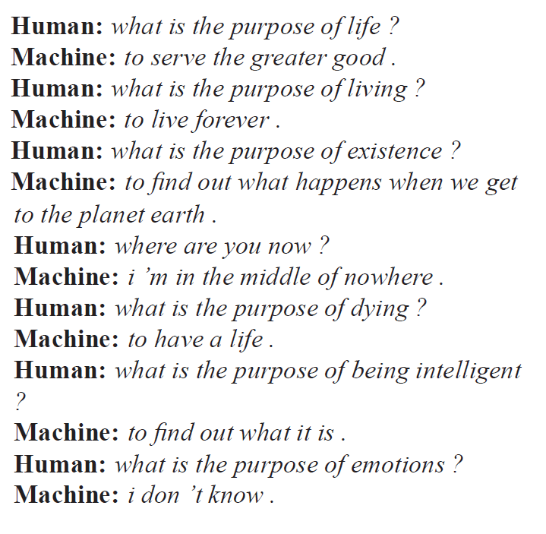
Chatbot RNN
Trained on movie subtitles
Vinyals and Le, arxiv.org/abs/1506.05869

Slide 27
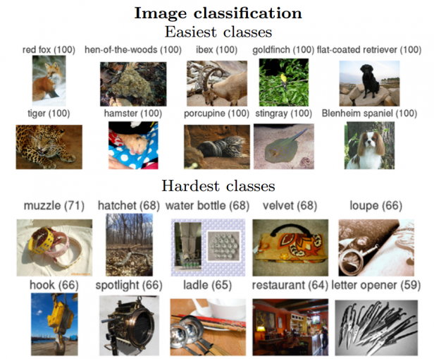
State-of-the-art examples
Move to deep neural networks:
AlexNet
Google Inception-ResNet
GoogLeNet
Microsoft
Residual
Net
1.2M train images, 100k test images, 1000 categories
Notes:
27

Slide 28
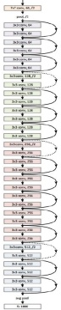
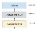
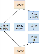
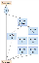
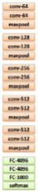
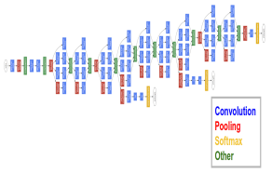
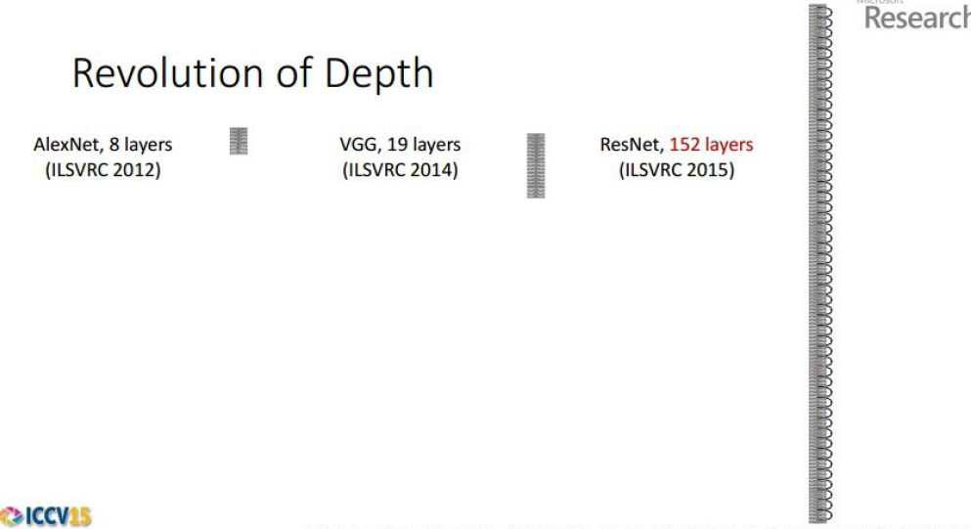
Image Classification NN
AlexNet
8 layers
(2012)
VGGNet
19 layers
(2014)
GoogLeNet
22 layers
(Google 2014)
ResNet
152 layers
(Microsoft 2015)
Inception-Resnet v4
75 layers
(Google 2016)
Notes:
28

Slide 29
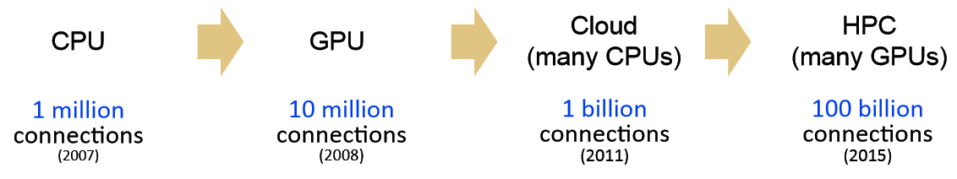
Computing Power
Why now?
Compute power (Moore’s law, GPU, cluster)
Availability of big data (shared curated datasets, internet, web companies)
Tweaks in training methods (the architectures are from the 90’s)

Slide 30
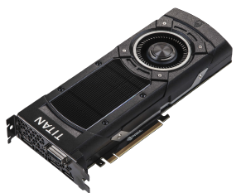
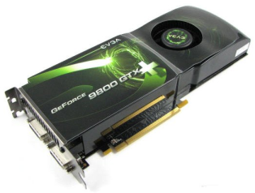
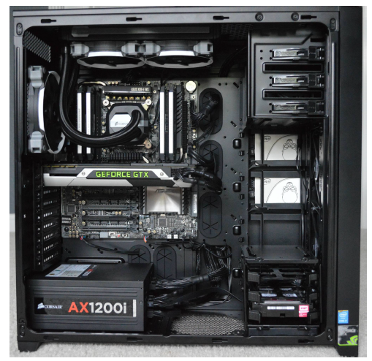
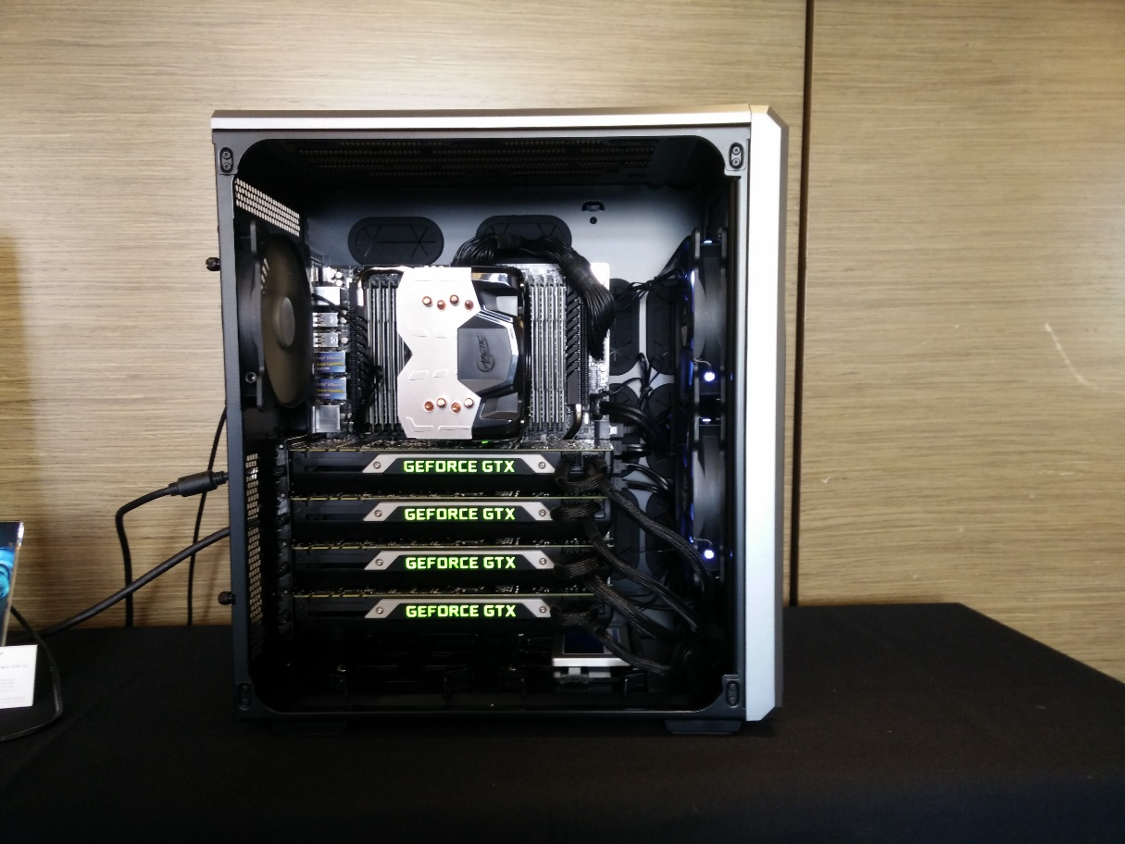
GPU
Titan X (2015)
Pascal (2016)

Slide 31
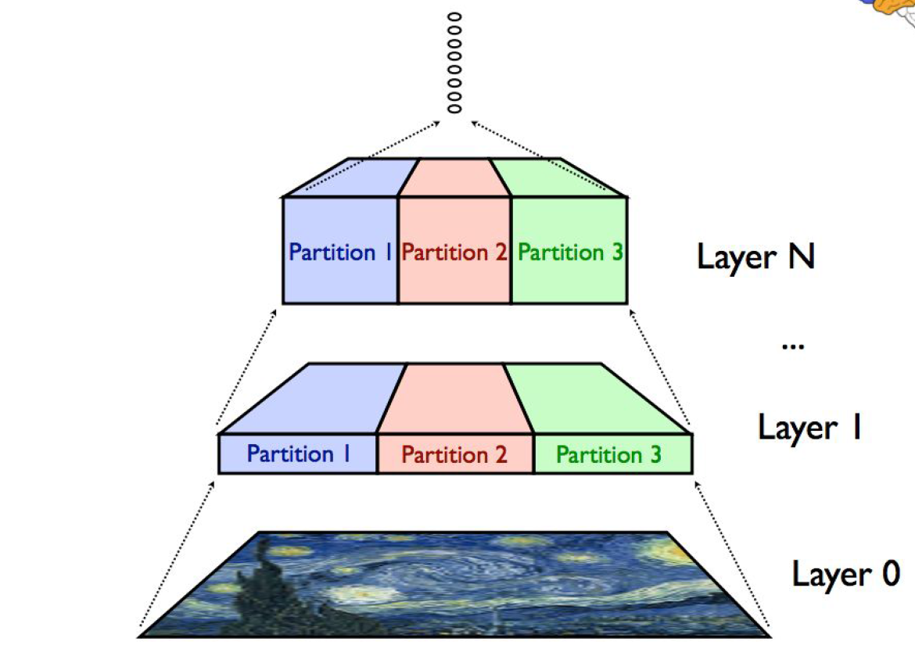
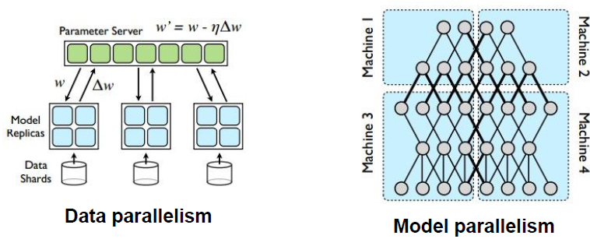
Type of Parallelism

Slide 32
Frameworks
Theano (Toronto University)
Torch (Facebook)
Caffe (Berkley University)
TensorFlow (Google)

Slide 33
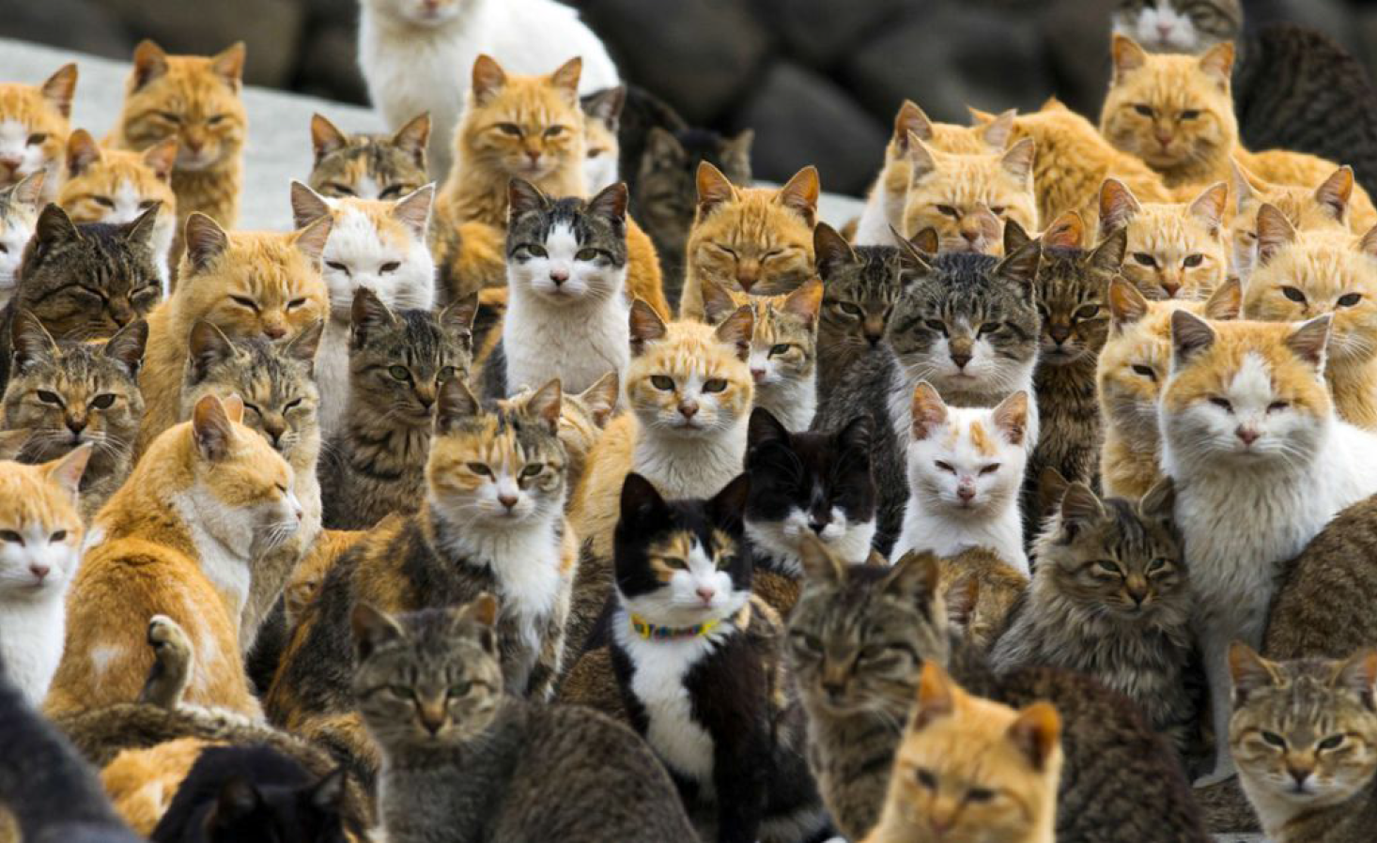
Object Detection and Recognition

Slide 34


Object Detection and Recognition
Localization, Tracking
Occlusion

Slide 35



Object Detection and Recognition
video

Slide 36

Image Captioning
Karpathy and Fei-Fei, arxiv.org/abs/1412.2306
Standord NeuralTalk2:
Baidu/UCLA (Mao et al.) arxiv.org/abs/1412.6632
Toronto Image2Text

Slide 37



Image Captioning
white cat
white cat

Slide 38

Image Captioning With Attention
Fang et al., arxiv.org/abs/1411.4952

Slide 39


Image Captioning With Attention

Slide 40

Visual Question Answering with Attention
Xiong et al., arxiv.org/abs/1603.01417

Slide 41

Visual Question Answering with Attention
Chen et al. “” ABC-CNN: An Attention Based Convolutional Neural Network for Visual Question Answering (2015)

Slide 42

Video Captioning
Human pose estimation (video)
Yu et al., arxiv.org/abs/1510.07712

Slide 43


word2vec Word Embedding

Slide 44



GLOVE Word Embedding

Slide 45

Visual-Semantic Embeddings and Arithmetics
Kiros et al., arxiv.org/abs/1411.2539

Slide 46

Visual Arithmetics
Radford et al., arxiv.org/abs/1511.06434

Slide 47

Visual-Semantic Embeddings and Arithmetics
Generative Adversarial Network

Slide 48

Reinforcement Learning: Atari Arcade Game Playing
Professional human gamer level
video
Mnih et al., Nature 14236 (DQN)

Slide 49


AlphaGo (Google)
Go is much harder than chess:
Number of possible states vs. in chess ( atoms in the observable universe)
Classical AI tree search + 2 convolutional nets:
Value network to evaluate board positions
Policy network to select moves
Trained by a novel combination of
Supervised learning from human expert games
Reinforcement learning from games of self-play
Defeated the top Go player Lee Sedol by 4 games to 1 (Mar 2016)

Slide 50


Skype “Universal” Translator (2014)
Chinese
English
French
German
Italian
Spanish
video

Slide 51

Google Deep Dreams

Slide 52

Google Deep Dreams
Video: Grocery Trip

Slide 53



Neural Artistic Style
Features from object recognition deepart.io
+
=
video

Slide 54


Slide 55



